Slide 1
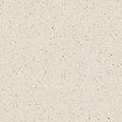


Slide 2
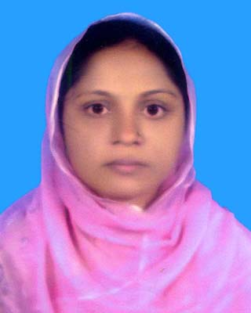
INTRODUCTION
Selina Akter
Asst:Teacher(English)
Bahadder kata High School,
Chakaria,Coxs bazar.
selikamal8485@gmail.com
Class :Eight.
Sub: English 1st Paper
Time:40 minutes

Slide 3
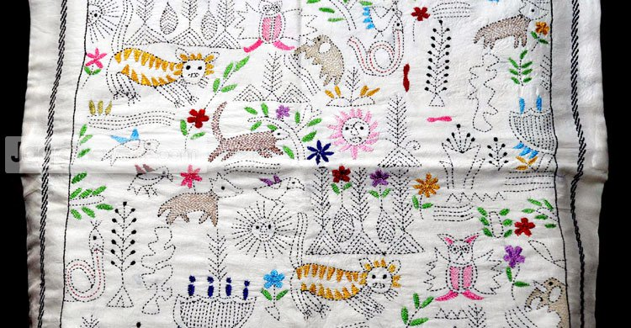
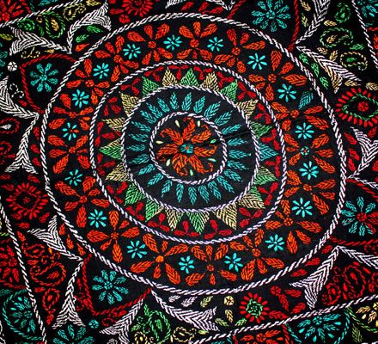
Lets see some pictures-
What do you see in the picture?
What is called?

Slide 4
Lets watch a video …….

Slide 5
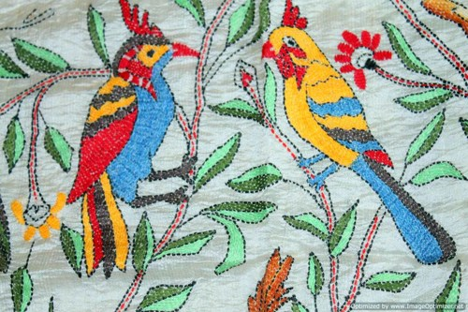
Today’s topic is--
Nakshi Kantha
Unit-6
Lesson:2,page:64

Slide 6
Learning outcomes
By the end of the lesson, we will be able to-
ask and answer questions;
read and understand text through silent reading;
Write short paragraph.

Slide 7
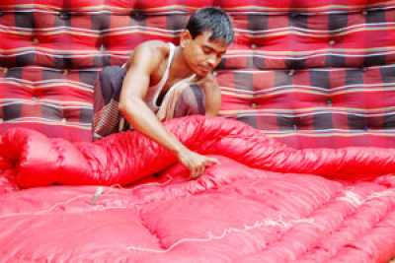
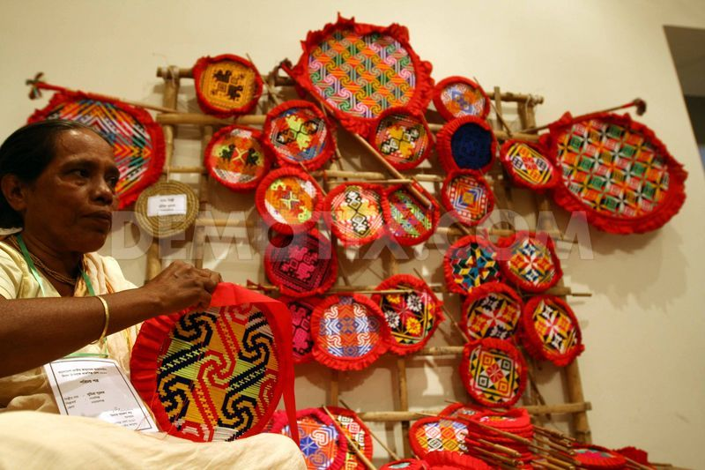
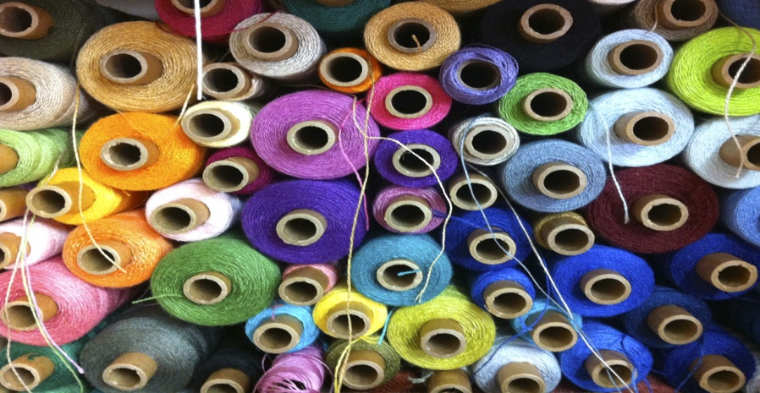
Vocabulary
Quilt
Mattress
Handicrafts
Craft
Thread
Fiverd

Slide 8

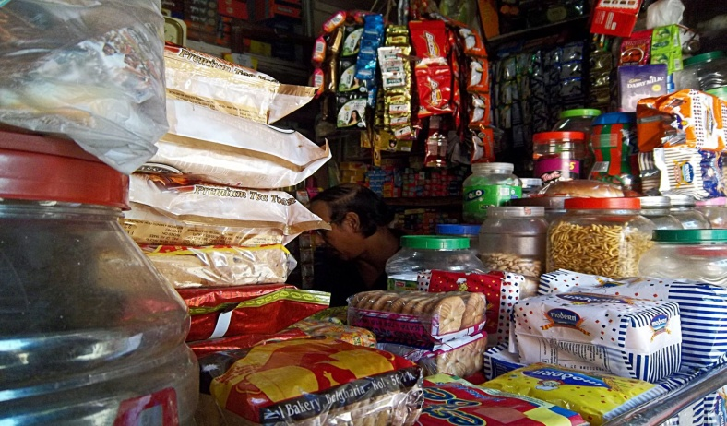
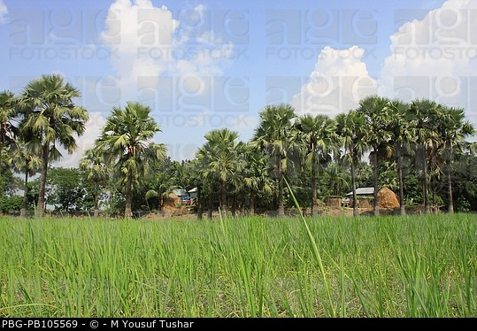
Cloth
Dress
Shop
Departmental store
Rural
Country side

Slide 9
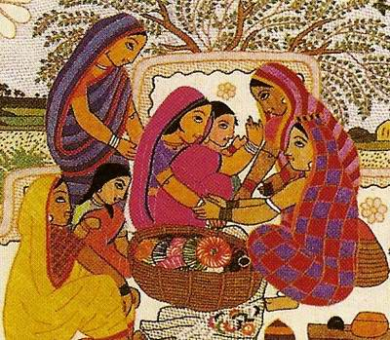
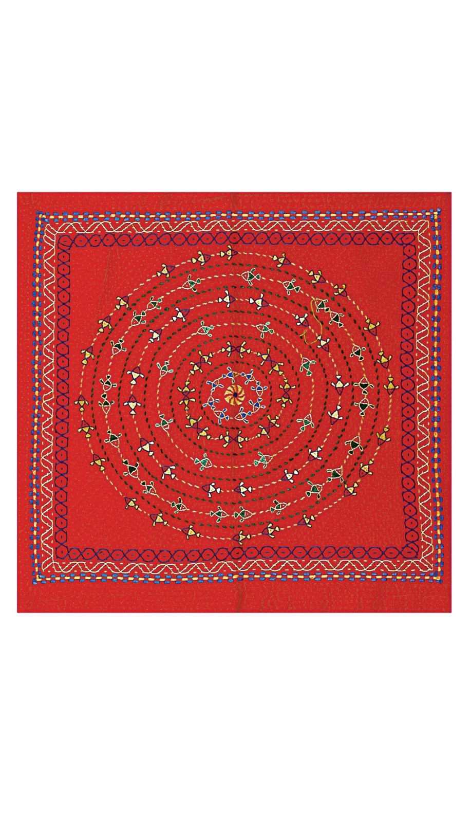
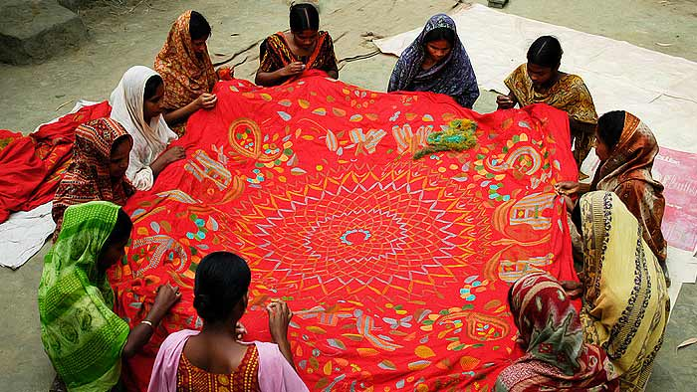
Lets know about the “Nakshi kantha”---
The name was taken from the Bengali word “NAKSHA”
Nakshi kantha is a kind of
Embroidered quilt.
The art has been practised in”Rural Bangla”

Slide 10
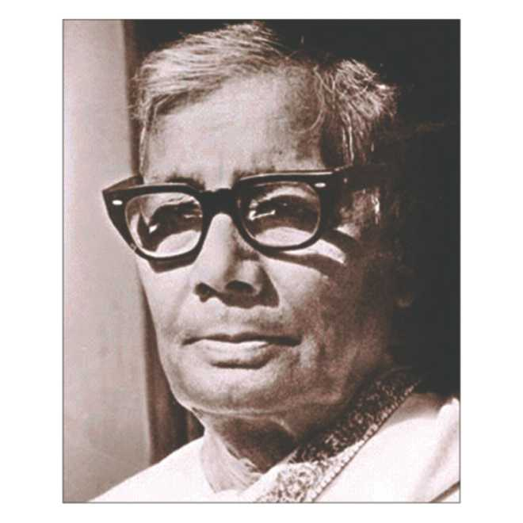
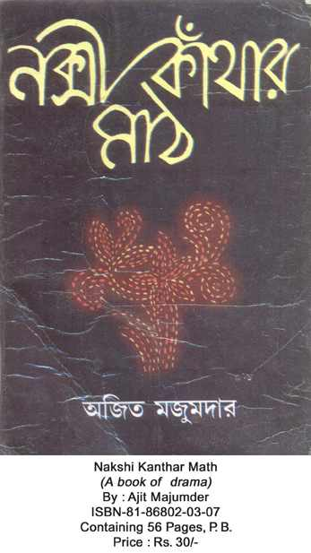
Do you know the person? lests know more about the person--
Date of birth:
1 January 1903
Birth place:
Faridpur District
Published in-
Polli kobi Jasim uddin
1929

Slide 11
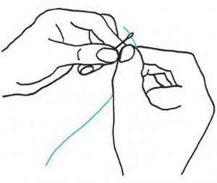
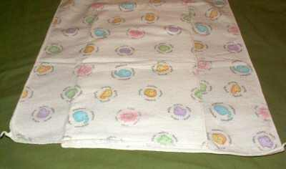
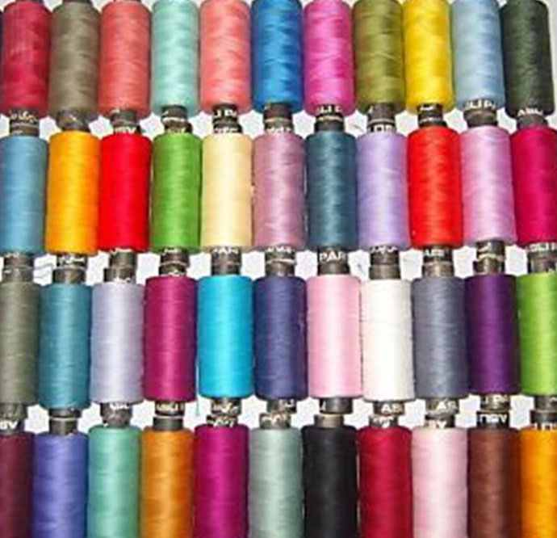
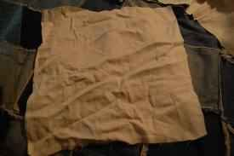
To make a nakshi kantha we need
Needle
New cloth
Colorful thread
Old cloth

Slide 12
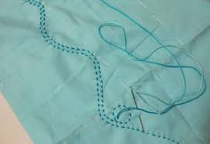
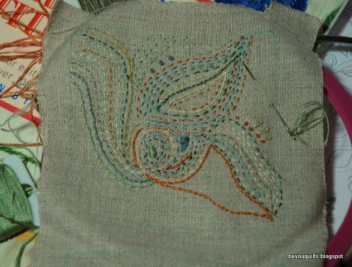
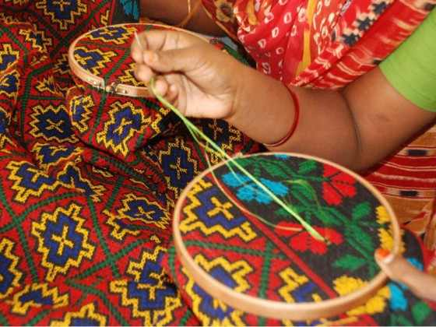
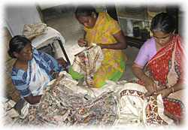
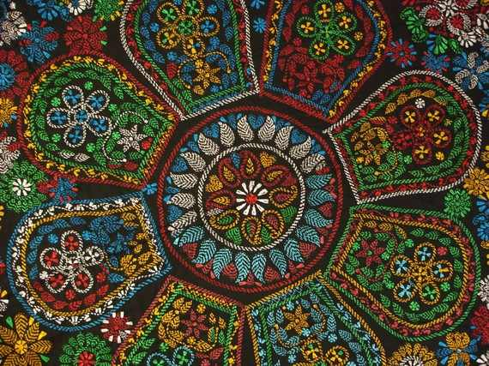
The process of making Nakshi kantha
Step 1
Step 2
Step 3
Step 4
Step 5

Slide 13

Do you like nakshi kantha or an ordinary kantha?Why?

Slide 14
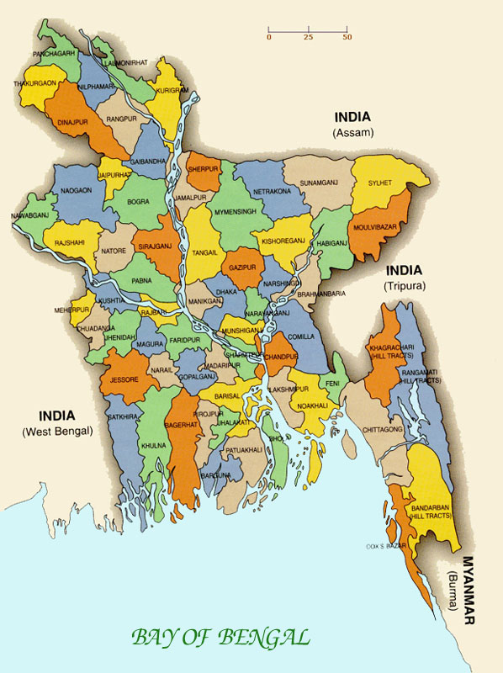
Which places are famous for making Nakshi Kantha?
Bogra
Rajshahi
Jamalpur
Mymensing
Faridpur
Jessore

Slide 15
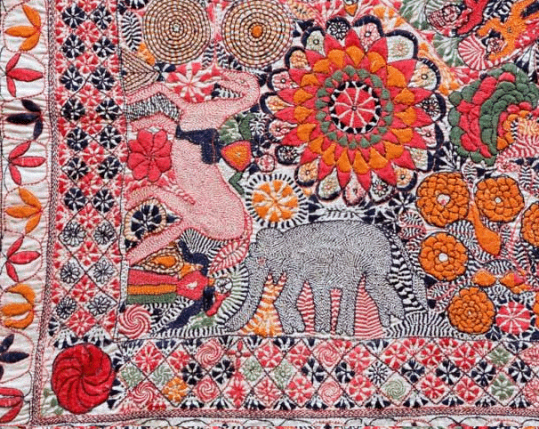
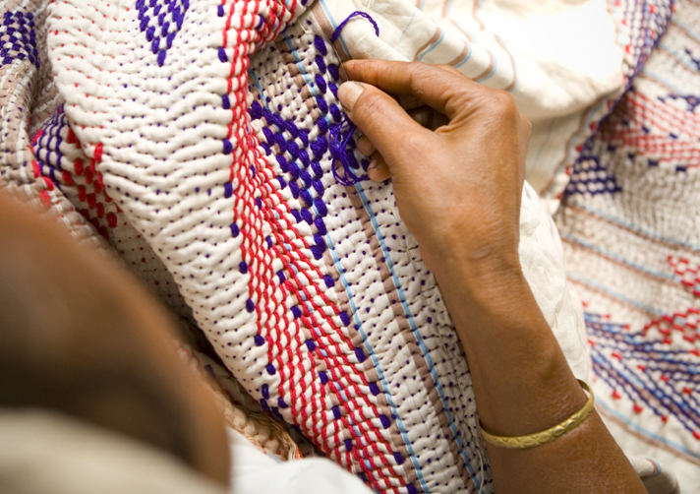
Traditional kanthas
Are made for family use.
Old or new cloths and thread are used to make kanthas.

Slide 16
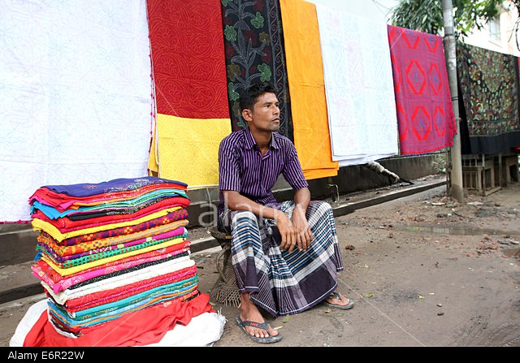
Now nakshi kantha produced in commercially

Slide 17
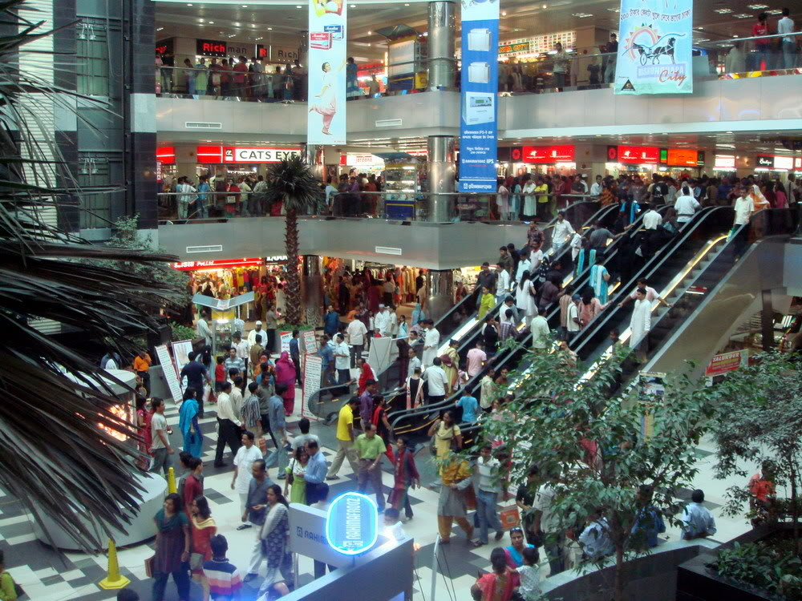
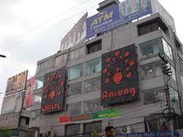
We find nakshi kantha in many expensive handicraft shops in cities.

Slide 18
Individual work
Students read the text silently and complete the sentences with cluses given-
Bengali | Embroidery | fashion | Quilt | rural
Patterns | Years | Art | Noksha | designs
Naksha means artistic_______
The name was taken from a __________________word________________
The art has been practised in ______________Bengal for____________
Nakshi kanthas are now sold in______________ shops.
Nakshi kanthas are in geat demand because of their colourful________________and____________.
Nakshi kanthas are a kind of ________________
pattern
Bengali
noksha
rural
years
embroidery
designs
patterns
quilt

Slide 19

Evaluation
Evaluation
What is “Nakshi kantha?”
Who wrote “nakshi kanthar math?”
Where was the name taken from?
What are used to make “Nakshi kantha”?

Slide 20

ANSWER
Nakshi kantha is a kind of embroidered quilt.
Jasim uddin wrote “Nakshi kanther math.”
The name was taken from bengali word “Naksha”.
Old or new cloth and thread are used to make Nakshi kantha.

Slide 21

Home work
Write a paragraph about “Nakshi kantha”

Slide 22

